Slide 1
Convolutional Neural Network
코드 in Theano

Slide 2
CNN overall procedures
Softmax Output
MLP
Pooling
Convolutional Layer
Input Image

Slide 3
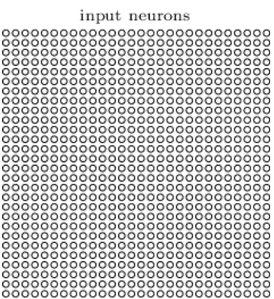
Input Image
4D tensor
- Input Images -
[해당 배치 내 데이터 번호,
인풋 feature map 번호, 높이, 너비]
[ i, j, k, l ] =
Mini batch 100
Mini batch 1
50,000 images
in the training data
5
5
7
8
28
...
28
...
500
Input Image
28
500
28
. . .

Slide 4
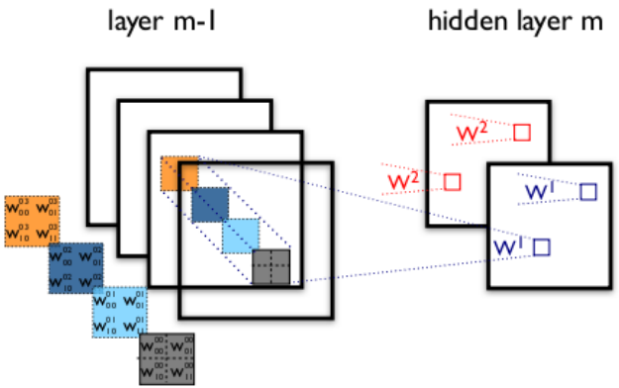
Weight tensor
4D tensor
- Weight -
[ o, p, q, r ] =
[m번째 layer의 feature map 번호, m-1번째 layer의 feature map 번호, 높이, 너비]
Convolutional Layer
Input Image

Slide 5
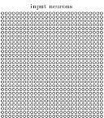
Exercise for Input and Weight tensor
Input layer
Convolutional layer 1
Convolutional layer 2
[ 1, 1, 1, 1 ]
[ 1, 1, 1, 1 ]

Slide 6
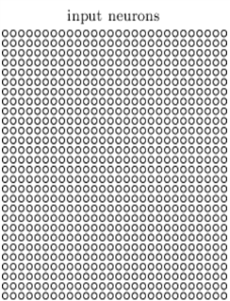
Code for Convolutional Layer
20
20
50
50
20
50
8
5
24
12
5
8
4
28
5
24
12
5
8
4
28
12 – 5 + 1 = 8
Convolution
8 / 2 = 4
Pooling
28 – 5 + 1 = 24
Convolution
24 / 2 = 12
Pooling
Layer0 – Convolutional layer 1
def evaluate_lenet5(learning_rate=0.1,
n_epochs=2, dataset=‘minist.pkl.gz’,
nkerns=[20, 50], batch_size=500):
image_shape=(batch_size, 1, 28, 28)
filter_shape=(nkerns[0], 1, 5, 5)
poolsize=(2, 2)
Class
Layer1 – Convolutional layer 2
LeNetConvPoolLayer
image_shape=(batch_size, nkerns[0], 12, 12)
filter_shape=(nkerns[1], nkerns[0], 5, 5)
poolsize=(2, 2)

Slide 7
Output layer
Zero-Padding
Input layer
Hidden layer
(Feature map)
Pooling
Convolutional Layer
Input Image

Slide 8
Output layer
Zero-Padding
Input layer
Hidden layer
(Feature map)
0
0

Slide 9
Output layer
Zero-Padding
Input layer
Hidden layer
(Feature map)
0
0

Slide 10
Output layer
Zero-Padding
Input layer
Hidden layer
(Feature map)
0
0

Slide 11
Output layer
Zero-Padding
Input layer
Hidden layer
(Feature map)
0
0

Slide 12
Output layer
Zero-Padding
Input layer
Hidden layer
(Feature map)
0
0
0
0

Slide 13
Output layer
Zero-Padding
Input layer
Hidden layer
(Feature map)
0
0
0
0

Slide 14
Zero-Padding
0
0

Slide 15
Zero-Padding
0
0

Slide 16
Zero-Padding
0
0

Slide 17
Zero-Padding
0
0
0
0

Slide 18
Zero-Padding
0
0
0
0

Slide 19
Zero-Padding
0
0
0
0

Slide 20
Zero-Padding
No zero-padding
Zero-padding 1
Zero-padding 2
Default in Theano
Zero-padding in Theano
Dimension 감소
Dimension 일치
Dimension 증가

Slide 21
Code for Zero-Padding setting in Theano Library
conv.py (라이브러리 파일)
def conv2d(input, filters, image_shape=None, filter_shape=None,
border_mode=‘valid’, subsample=(1, 1), **kargs):
‘valid’
‘full’
Image_shape - filter_shape + 1
Image_shape + filter_shape – 1
28 - 5 + 1 = 24
28 + 5 – 1 = 32
Dimension 변화는 위와 같으며, 코드 내에서 모드 반영하여 수작업으로
수정해주어야 한다!

Slide 22
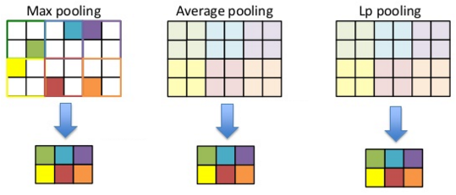
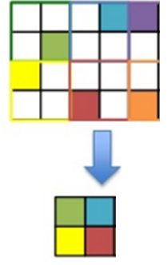
1. Border in Pooling
No problem in Border
Ingore_border = False
Ingore_border = True

Slide 23
1. Border in Pooling (Code)
Ingore_border = False
Ingore_border = True
No problem in Border
Class
LeNetConvPoolLayer
pooled_out = downsample.max_pool_2d(input=conv_out, ds=poolsize, ignore_border=True)
라이브러리 Theano안에는 False가 Default이다.

Slide 24
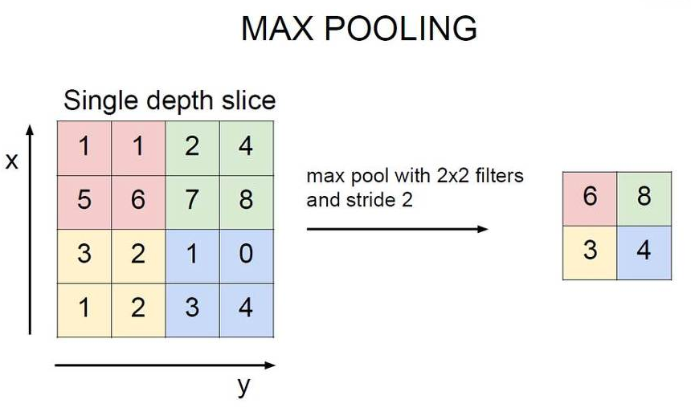
2. Stride in Pooling
Default in Theano
stride size = poolsize
겹치지 않게 Pooling 한다!

Slide 25
2. Stride in Pooling
2
Default in Theano
stride size = poolsize
겹치지 않게 Pooling 한다!

Slide 26
2. Stride in Pooling
2
Default in Theano
stride size = poolsize = (2,2)
겹치지 않게 Pooling 한다!

Slide 27
2. Stride in Pooling
Default in Theano
stride size = poolsize = (2,2)
겹치지 않게 Pooling 한다!
2

Slide 28
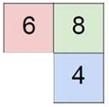
2. Stride in Pooling
Default in Theano
stride size = poolsize = (2,2)
겹치지 않게 Pooling 한다!
2

Slide 29
2. Stride in Pooling
stride size = (1, 1)
6

Slide 30
2. Stride in Pooling
1
6
7

Slide 31
2. Stride in Pooling (Code)
pooled_out = downsample.max_pool_2d(input=conv_out, ds=poolsize, ignore_border=True)
pooled_out = downsample.max_pool_2d(input=conv_out, ds=poolsize, ignore_border=True, st = (1,1))
6
7
8
Dimension이 바뀌는 것은 이것 또한 수작업으로 계산하여 수정해주어야 한다!
6
7
8
3
3
4

Slide 32
Activation Function in Convolutional Layer
Convolution
Pooling
Activation
Class
LeNetConvPoolLayer
self.output=T.tanh(pooled_out + self.b.dimshuffle(‘x’,0,‘x’,‘x’)

Slide 33
Dimension Reduction 2D → 1D
layer2_input = layer1_input.output.flatten(2)
1D - Output neurons
2D - Output neurons
MLP
Pooling
Convolutional Layer
Input Image

Slide 34
Code for MLP in Theano
*** MLP에서 Hidden Layer의 개수를
늘리기 위해서는 아래의 코드를
반복하여 layer3를 자체 제작 해야
한다***
Class
HiddenLayer
MLP
layer2 = HiddenLayer( rng, input=layer2_input,
n_in-nkerns[1] * 4 * 4,
n_out=500,
activation = T.tanh)
Pooling
Convolutional Layer
C+P의 마지막 output의 크기
Hidden layer의 Node 개수
Input Image
Hidden layer의 Activation 함수

Slide 35
Code for Softmax Output in Theano
Class
Softmax activation function
Softmax Output
LogisticRegression
MLP
layer3 = LogisticRegression( input=layer2.output,
n_in=500,
n_out=10)
Pooling
cost = layer3.negative_log_likelihood(y)
Convolutional Layer
최종 Output의 개수
Ex) 0, 1, 2, ,,, 9
이전 Hidden Layer의 Node 개수
Input Image

Slide 36
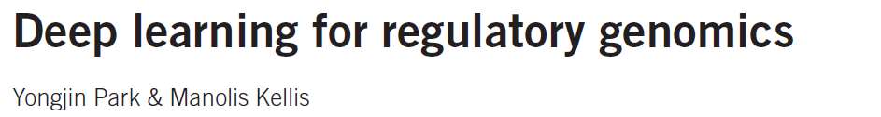
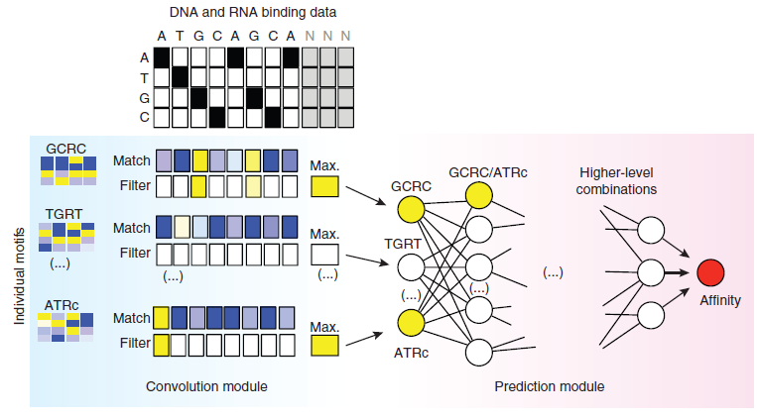
CNN application in bioinformatics problem

